Slide 1
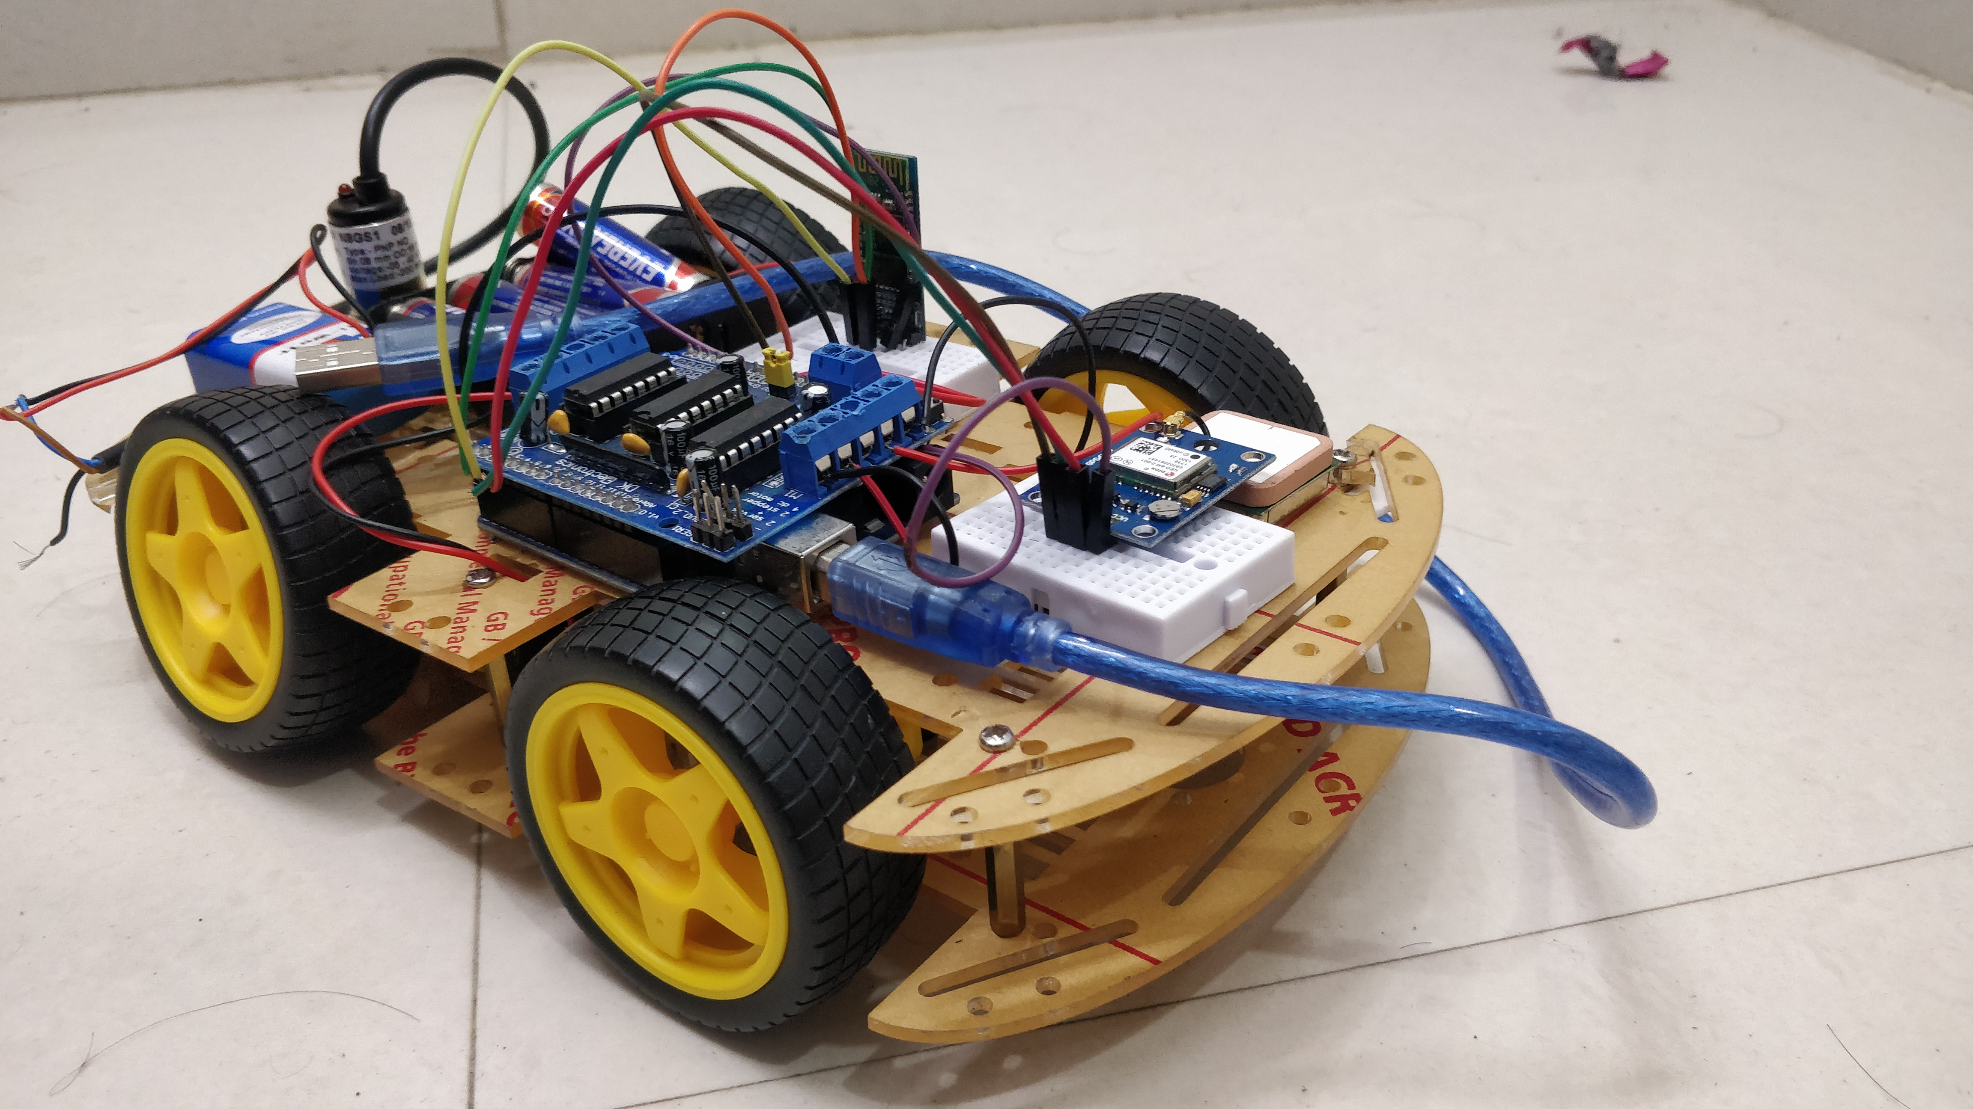
IOT BASED GESTURE CONTROLLED CAR FOR METAL DETECTION
Submitted by~
Prashant jha _17Bcs4532
Vishavdeep Singh – 17bcs4534
Kushal Choudhary _ 17BCSs4536
DHEERAJ KUMAR_17bcs3948
SHAGUN SAINI_17bcs4538

Slide 2
contents
ABSTRACT
INTRODUCTION
APPLICATIONS
MOTIVATION & OBJECTIVE
MATERIALS REQUIRED
WORKING
CONCLUSION

Slide 3
Robot
Robot is an electo-mechanical machine that can perform tasks automatically. Robots may require guidance that can be achieved using remote control or computer interface.
HUMAN MACHINE INTERACTION
An important aspect of successful robot systems is human-machine interaction. With the development in science and robotics, gesture based recognition came into existence.

Slide 4
Applications
Through the use of gesture recognition, remote control of devices is possible through a wave of hand.
Gesture controlling is very helpful in circumstances where solution is achieved by risking life of humans physically.
Thousands of lives are lost in defence sector in order to keep their territory safe and this must be avoided. Science and robotics development has enforced better technologies for the defence sector and one of such technology is the gesture controlled car.

Slide 5
Applications
Gesture controlled car is a prototype which can be further build to perform various physically human incompatible tasks in mining , construction , manufacturing medical etc;
Therefore , this prototype is feasible to deploy in the defence sector to detect landmines.
Gesture controlling is very helpful in developing automatic wheel chairs for physically disabled.

Slide 6
Objective of project
Our objective is to make the device simple as well as cheap so that it can be implemented easily and mass produced and can be used for a number of purpose.
We need constant change, technological innovation capability, and high productivity to survive in the fierce competitive environment.

Slide 7
Materials Required
Bread board
Car chasis kit
HC05 Bluetooth module
Jumper wires
Dc 9v holder
Metal detector for Arduino
NEO 6M GPS Module
Arduino UNO
USB cable
9v battery

Slide 8
Working
The working of gesture controlled car is based on the principle of accelerometer. Accelerometer is a sensor that senses any physical movement or gesture and is induced in a device which is to be equipped by the user in his hands. In case of our device is a smarphone containing multiple sensors.
The accelometer senses the movement and sends the information to the arduino via a Bluetooth communication module. The arduino then decodes the data recieved and sets certain voltages respectively as per the data recieved. This certain voltages are then transfered to the motors which moves the car in the particular specific direction.

Slide 9
WORKING
The gesture controlled car is equipped with metal detector sensor having the capability to detect landmines. Whenever, the car rolls over any metal or landmine, it detects it. For further accuracy to reduce false alarm rate of detection, it can also be equipped with a nitrogenous compound detection sensor.
The car will detect the landmine and send the location of the landmine to the user via NEO 6M GPS Module.
The user will have a confirmed location of the particular landmine.

Slide 10
CONCLUSION
So, all in through this project we can help our country forces of our country by detecting explosives or another harmful material’s which are buried some where in land or some places which are not accessible by human.
Secondly, no only for explosive detection this project also helps some archaeologist to get some old buried metallic material in land.

Slide 11
THANK YOU

